Slide 1
Netflix
Cleaning,
Analysis
and Visualization

Slide 2
Content
Project Title
Data from SQL
Objective
Tool Used
Dashboard & insights
Link

Slide 3
Objective
.
This Power BI project analyzes a dataset containing information about Netflix’s content library, including TV shows and movies available on the platform. The goal of the project is to gain insights into content distribution, release trends, and platform dynamics to help understand viewer preferences and Netflix’s content strategy.

Slide 4
Tool Used
1.Data Import & Integration
Get Data -Import data from CSV, databases
Power Query Editor-Clean, filter, and transform raw sales
Data Types-Format columns (Date,Text, etc.)
2.Data Modeling
Relationships- Link tables like release by year, type.

Slide 5
3. DAX (Data Analysis Expressions)-Used to create KPIs and calculated measures: Measure Example DAX Formula Total Sales = SUM(Sales[Total Price])
4. Data visulazation -
Line Chart | Release year by year
Bar/Column Chart | Release year by country,type
Donut/Pie Chart Slicer | Release year By rating
KPI Cards | Count of year shows
:

Slide 6
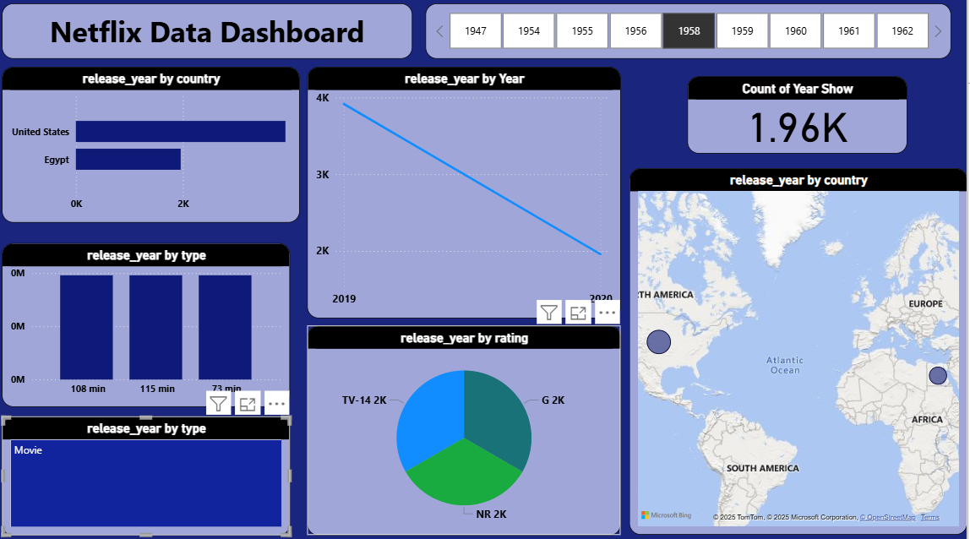
Output

Slide 7
Insights
Count of year show 1958 1.96K

Slide 8
https://github.com/manisharahul/Netflix-Data/upload/main

